Slide 1
Experiment seven
Searle's bar method for the conductivity of a good conductor

Slide 2
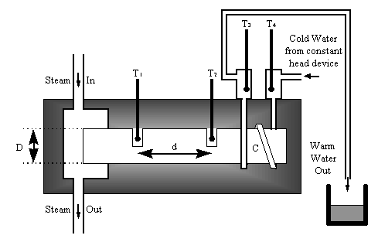
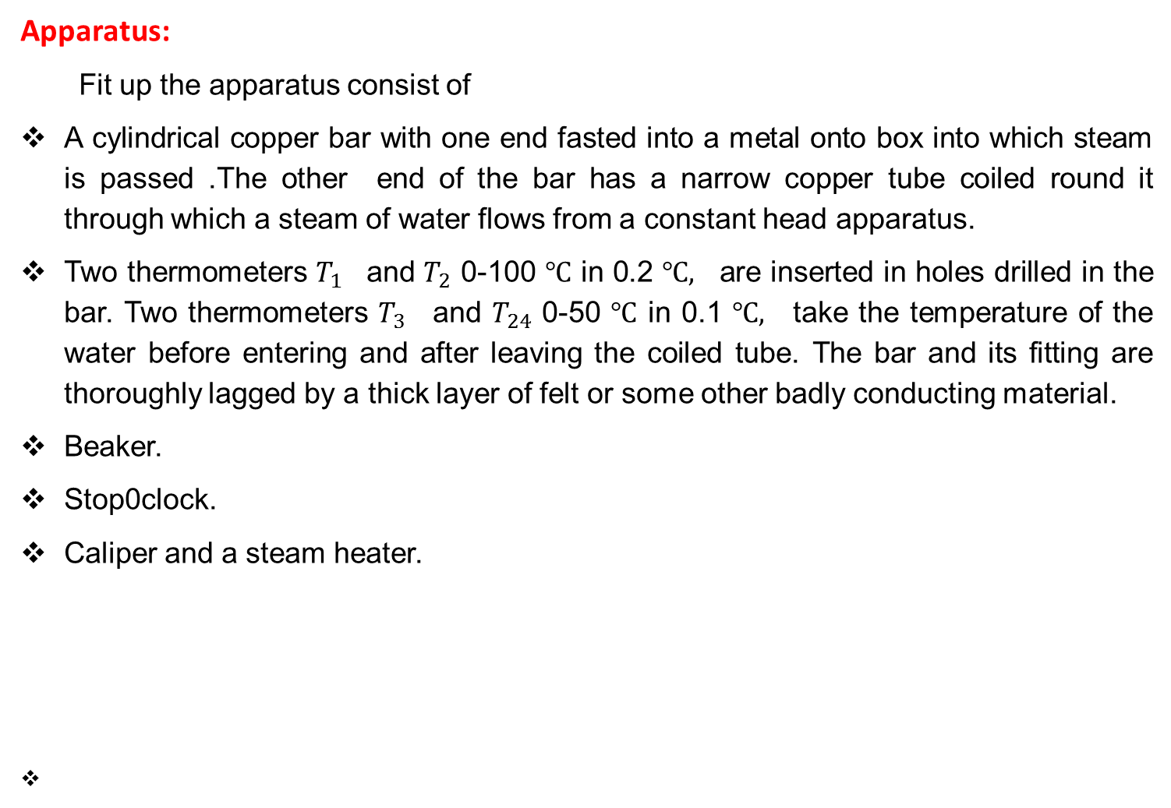
Apparatus:
Fit up the apparatus consist of
A cylindrical copper bar with one end fasted into a metal onto box into which steam is passed .The other end of the bar has a narrow copper tube coiled round it through which a steam of water flows from a constant head apparatus.
Two thermometers $T_{1 }$ and $T_{2 }$0-100 $℃$ in 0.2 $℃,$ are inserted in holes drilled in the bar. Two thermometers $T_{3 }$ and $T_{24 }$0-50 $℃$ in 0.1 $℃,$ take the temperature of the water before entering and after leaving the coiled tube. The bar and its fitting are thoroughly lagged by a thick layer of felt or some other badly conducting material.
Beaker.
Stop0clock.
Caliper and a steam heater.

